Slide 1
MCB Case Study – Engineering Lead (Data)
Nirantar Seewooruttun - 25th Nov 2021

Slide 2
Contents
BI Architecture Diagram
ETL Process
Power BI Report Layout
Q&A
Codebase access links
Appendix 1 to 7
Assumptions:
1. Reporting will be conducted on WDI Data
from 2010 onwards.

Slide 3
BI Architecture Diagram
Default files path → C:\sampledata
Staging Area
DWH Area
WDICountry.csv
STG_WDICOUNTRY
DW_DIM_COUNTRY
Reporting
WDIData.csv
STG_WDIDATA
DW_DIM_TIME
POWER BI
YearList.csv
STG_YEARS
CPI2020_GlobalTablesTS_210125.csv
STG_CPIDATA
DW_FACT_WDIDATA
Reference Tables – control loading of the data warehouse
Notes:
→ Developed locally on SQLServer Express edition. Local schema name : DBO → 2 views : VW_CPIDATA and VW_WDIDATA are used to extract data from staging area for DWH. WDIDATA.csv was first unpivoted on years then pivoted on KPIs for reporting.

Slide 4
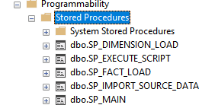
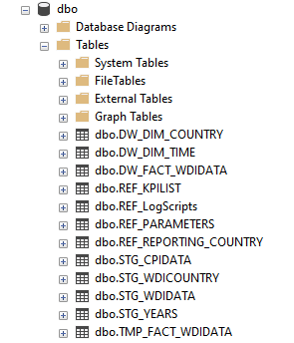

ETL Process
Default files path → C:\sampledata
EXECUTE SP_MAIN steps
→ SP_IMPORT_SOURCE_DATA :
Pulls source files from C:\sampledata\ folder
And loads data to staging tables.
→ SP_DIMENSION_LOAD : Loads data from staging tables to dimension tables
→ SP_FACT_LOAD : Loads data from staging fact tables in final fact table.
-------------------------------------------
→ REF_LogScripts table logs all scripts executed on the data warehouse

Slide 5
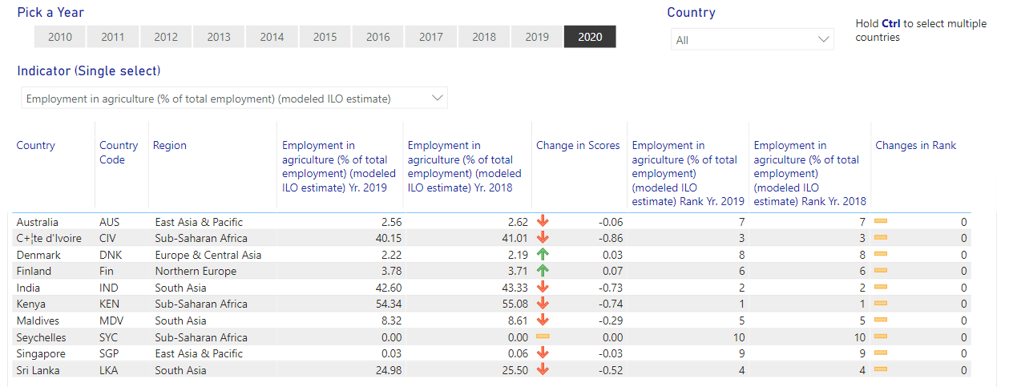
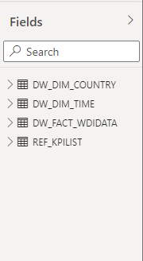
Power BI Report Layout

Slide 6
Questions

Slide 7
Codebase Access links
Backup Sample data
https://drive.google.com/file/d/1VWOya_LqnpVCqKHusGZXmGQAcJOYCniG/view?usp=sharing
Backup SQL Server Database link:
https://drive.google.com/file/d/14p87g9kVZGMRZiS7Y_DVbpvLkcV4dj47/view?usp=sharing
Codebase repository on GITHUB
https://github.com/hanuseew/MCBAssignment.git

Slide 8
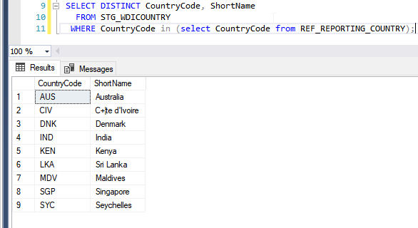
Appendix 1 – Test cases
List of countries in countries source data. → Finland manually added in SP_DIMENSION_IMPORT for the countries dimension : DW_DIM_COUNTRY

Slide 9
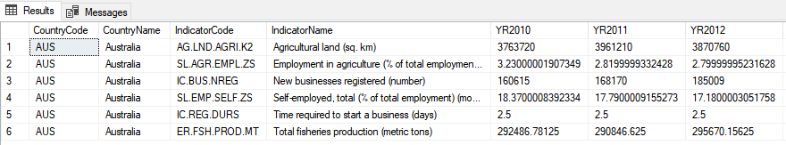
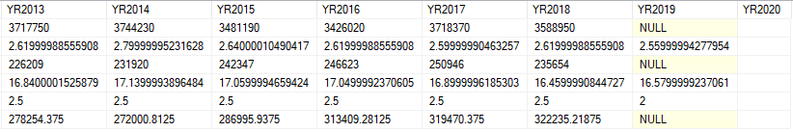
Appendix 2 – Source Data check for KPIs for one country - Australia
Data extract as per the source file:
SELECT CountryCode, CountryName, IndicatorCode, IndicatorName, YR2010, YR2011, YR2012, YR2013, YR2014, YR2015, YR2016, YR2017, YR2018, YR2019, YR2020
FROM STG_WDIDATA WHERE CountryCode = 'AUS'
and IndicatorCode IN (
'ER.FSH.PROD.MT',
'AG.LND.AGRI.K2',
'IC.REG.DURS',
'IC.BUS.NREG',
'SL.AGR.EMPL.ZS',
'SL.EMP.SELF.ZS');

Slide 10
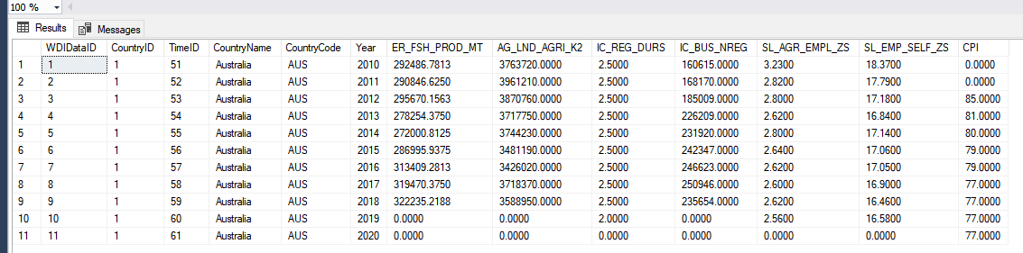
Appendix 3 – DWH Data check for KPIs for one country – Australia
Data extract as per data warehouse : (Data warehouse initialized as from Yr. 2010)
SELECT * FROM DW_FACT_WDIDATA where countrycode = 'AUS';

Slide 11
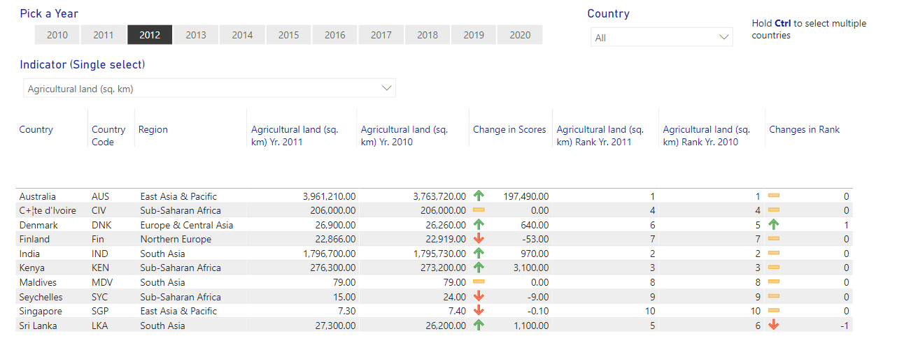
Appendix 4 – Power BI reporting for Australia on : “Agricultural Land (sq. km)” KPI for current year = 2012

Slide 12
Appendix 5 – Reference Tables
REF_KPILIST → Configuration table for list of reporting KPIs. Only this list of KPI will goto reporting
REF_LogScripts → Scripts of all DB procedures are logged in this log table.
REF_PARAMETERS → Initializes the year from which to pull fact data on the data warehouse.
REF_REPORTING_COUNTRIES → Initializes the list of countries for reporting. Can be modified to include more countries.

Slide 13
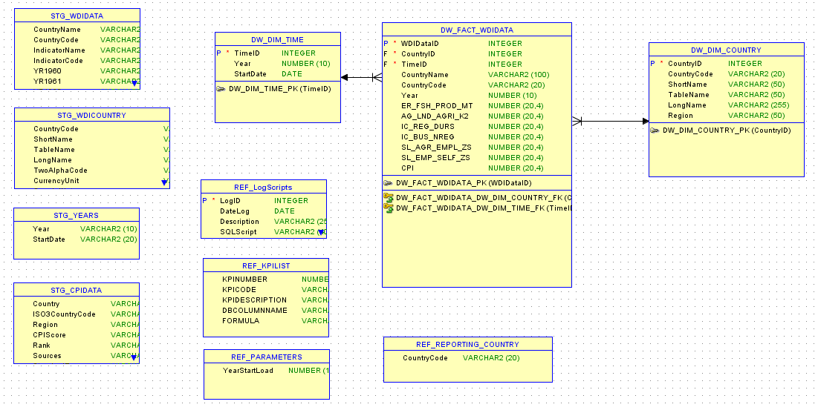
Appendix 6 - Data warehouse tables layout
2 dimensions and 1 fact table, 4 staging
And 4 reference tables

Slide 14
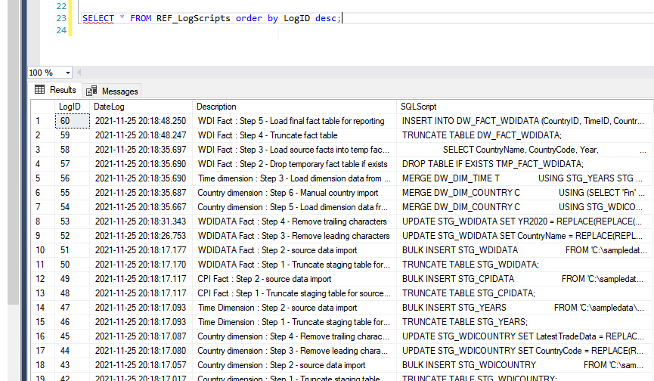
Appendix 7 – Log Table

